Slide 1

E-mail Spam Detection
Presented By- Group3
(Jaineet Kaur(20CSU046) & Pankil Kamboj(20CSU077)

Slide 2
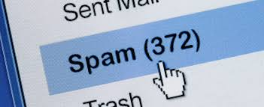
INTRODUCTION
Spam e-mails are annoying and dangerous too.
Spam mail can be defined as:
Mass mailings(bulk)
Unsolicited(unwanted)
Anonymous
Spam mail is junk mail mainly sent for commercial or phishing purposes.

Slide 3
PROBLEM STATEMENT
Unwanted e-mails irritating internet connection.
Critical e-mail messages missed and/or delayed.
Billions of dollars lost worldwide. (Email spam costs businesses $20.5 billion every year.)
Identity Theft
Spam crashes mail servers.

Slide 4
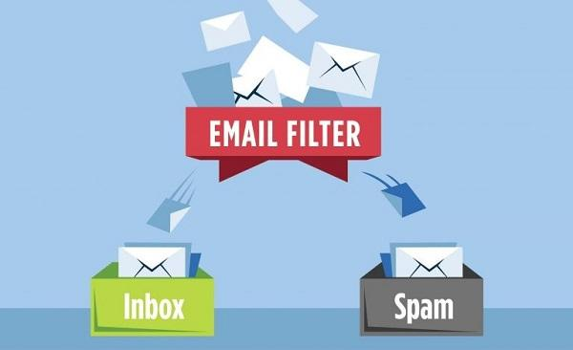
OBJECTIVE
The objective will be:
To help users differentiate between fake mails and relevant mails.
To classify a mail as spam or not.

Slide 5

LITERATURE REVIEW
We referred to a report from Kaspersky Lab,2015, and learned about this problem.
Spam prevention is often neglected but Big companies are trying different methods to reduce spam mail.
The different research articles helped us understand the technology being used
Like NLP, NN, etc
Specific signs showed by spam mail.
Like grammar errors or misspelled words

Slide 6



SCOPE
Provides Sensitivity to clients and will adapt to future spam techniques.
It increases Security and Control.
It will reduce costs:
IT Administration cost
Network Resource cost

Slide 7



Proposed Techniques
Natural Language Processing(NLP): concerned with the interactions between computers and human language, in particular how to program computers to process and analyze large amounts of natural language data. We are using NLTK here.
Recurrent Neural Network(RNN): a class of artificial neural networks where connections between nodes can create a cycle, allowing output from some nodes to affect subsequent input to the same nodes. This allows it to exhibit temporal dynamic behavior.RNNs can use their internal state (memory) to process variable-length sequences of inputs.[
Long Short-Term Memory(LSTM): These are a special kind of Neural Networks which are generally capable of understanding long-term dependencies.

Slide 8

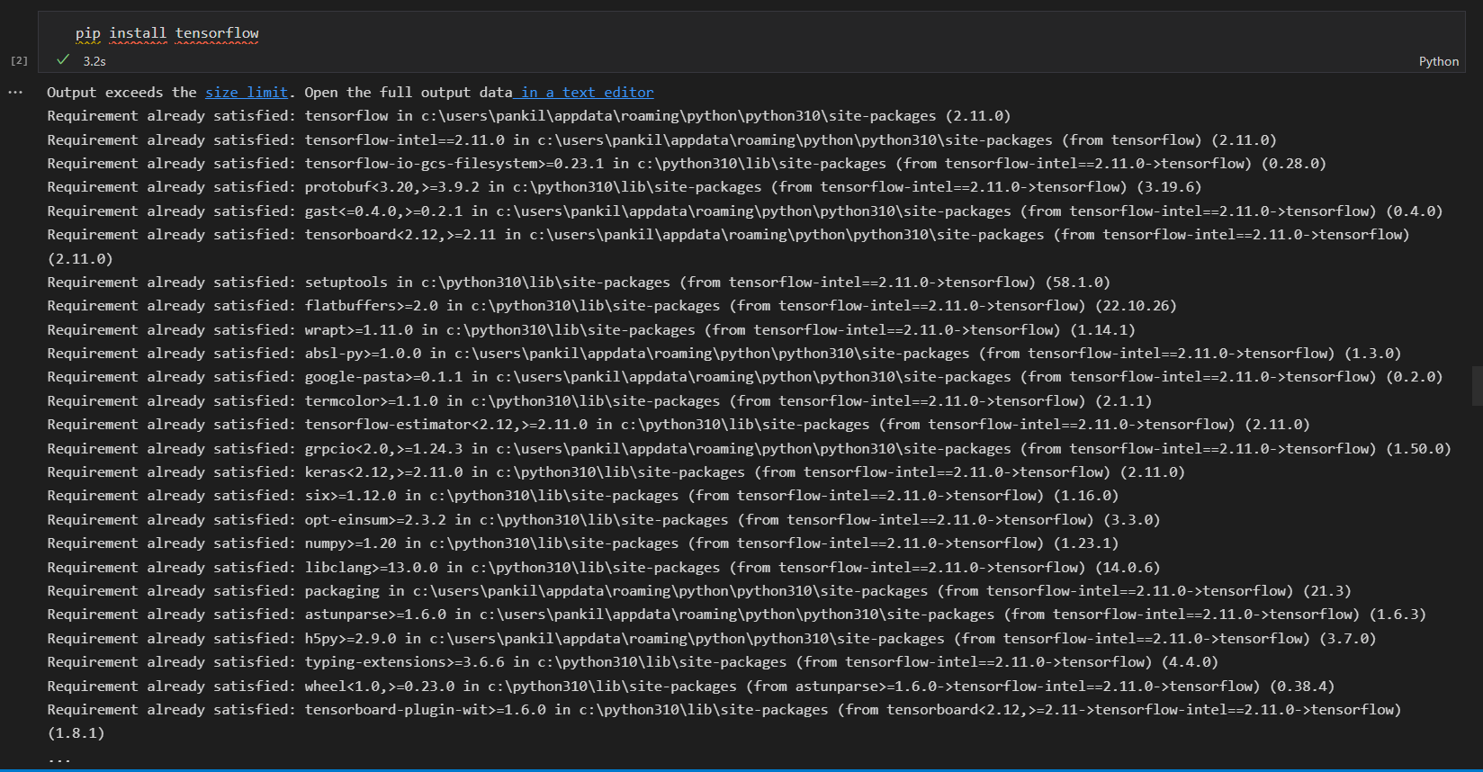
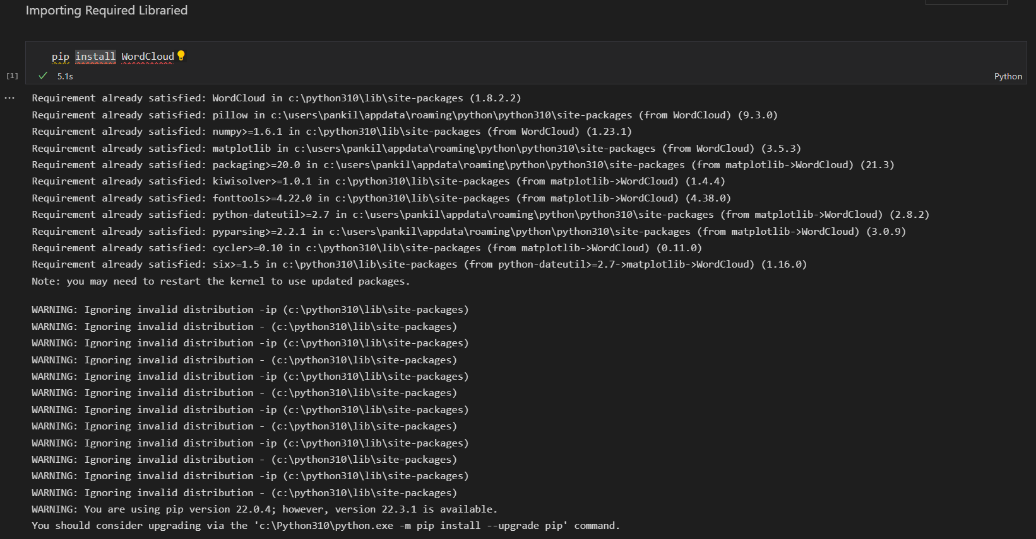
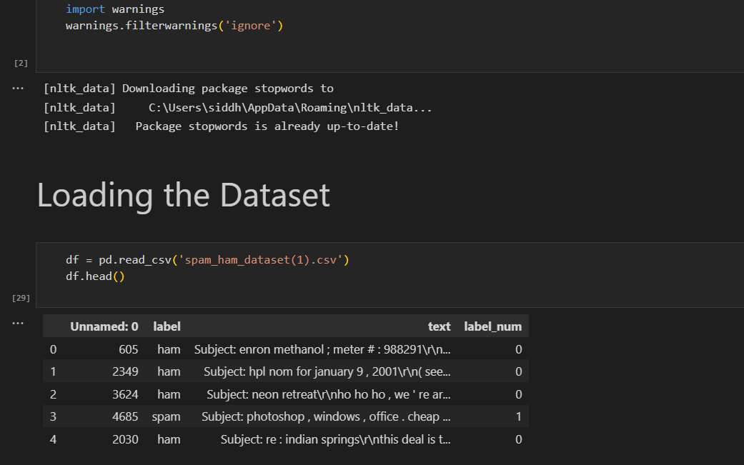
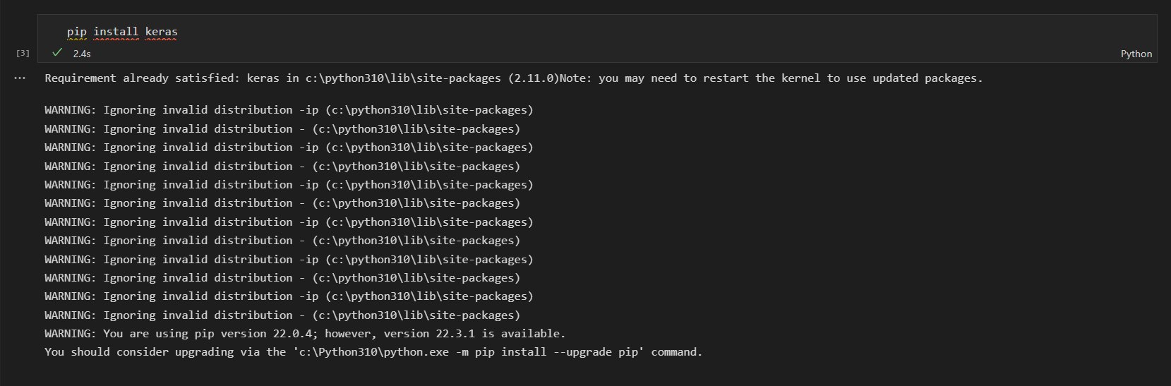
PROCEDURE
Importing libraries Numpy, Pandas, Matplotlib, NLTK, Tensorflow
Loading dataset

Slide 9
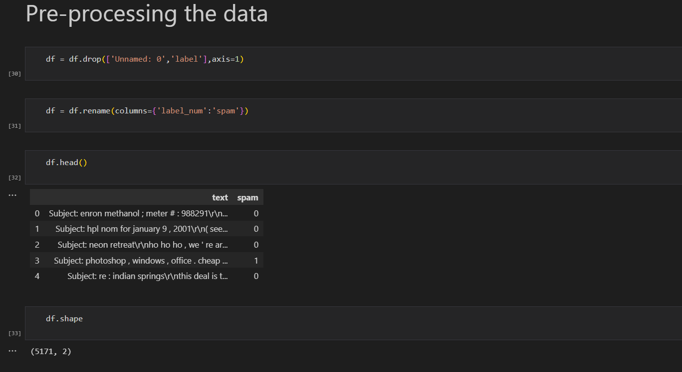
Data preprocessing
Removing discrepancies in the dataset
Removing punctuations and stop words

Slide 10
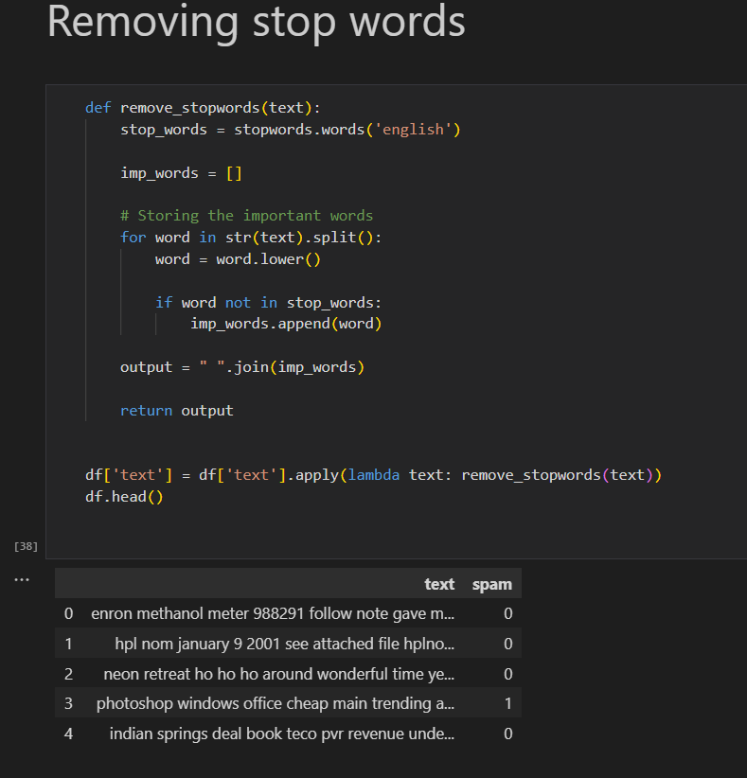
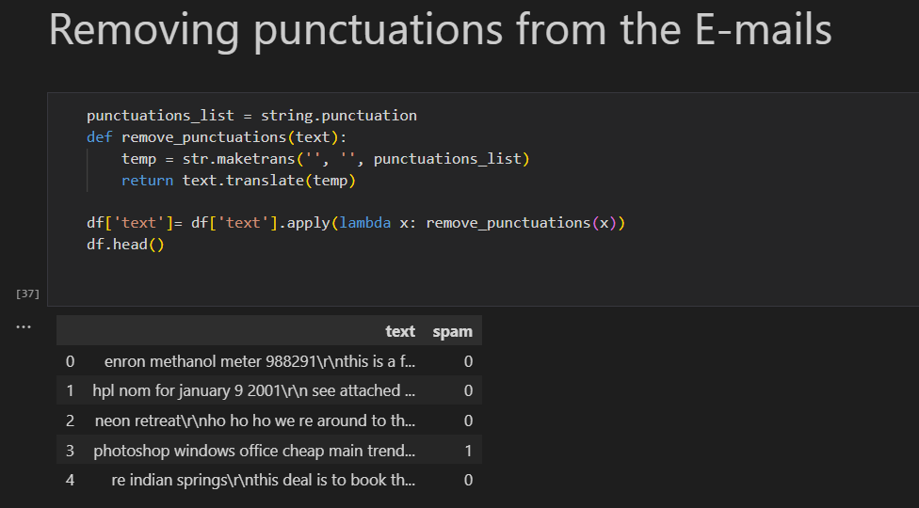

Slide 11
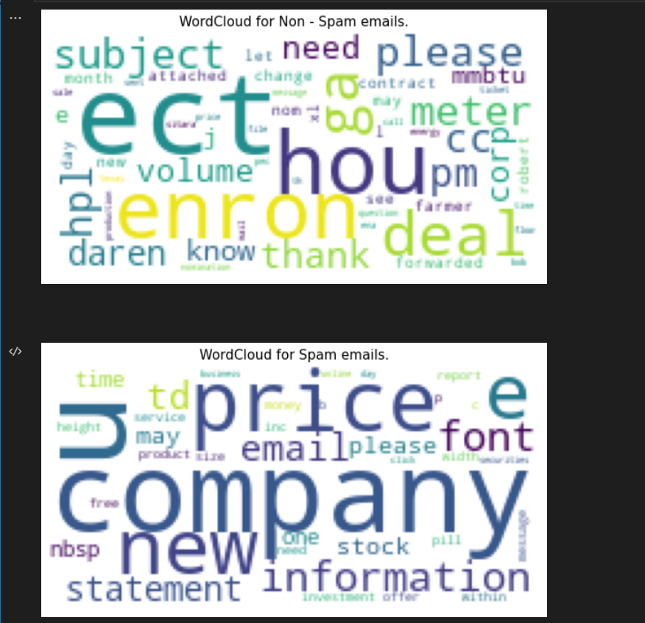
Word cloud

Slide 12
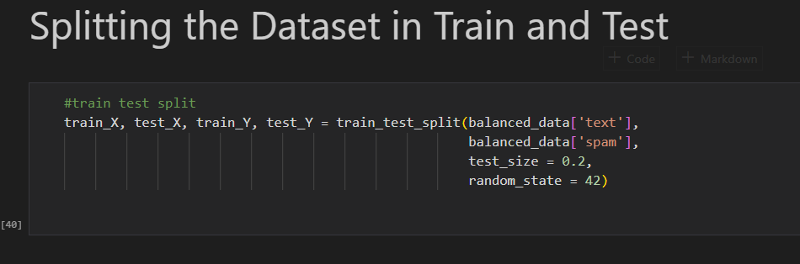
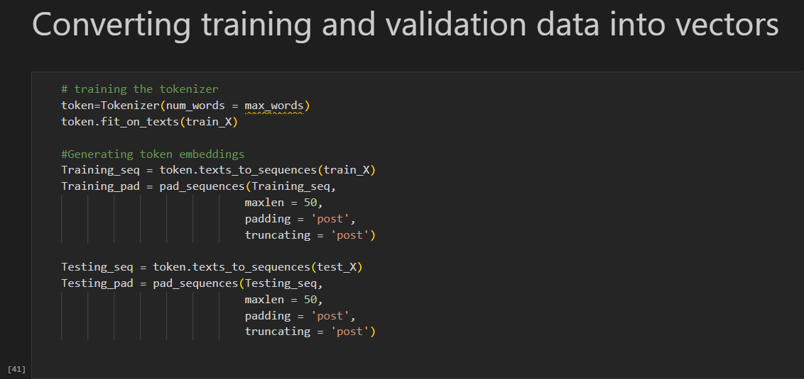
Tokenization is the process of breaking streams of texts into smaller meaningful words called tokens
Post adds zero for padding

Slide 13
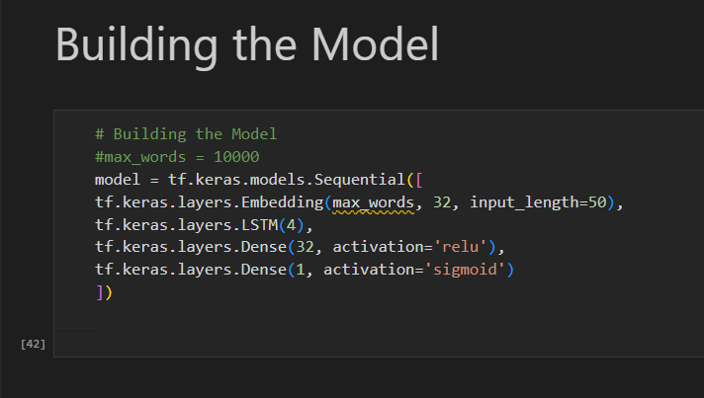
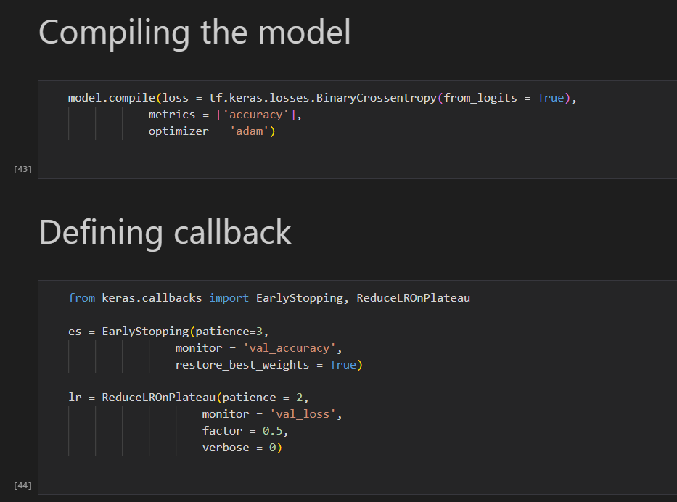
Model
Callbacks are used to check whether the model is improving with each epoch or not.

Slide 14
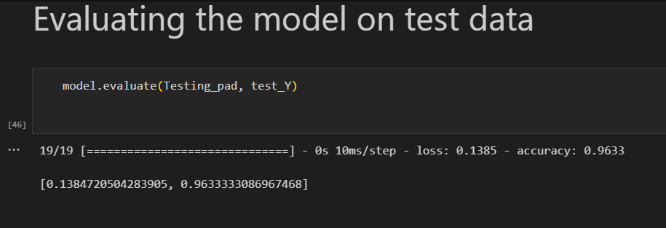
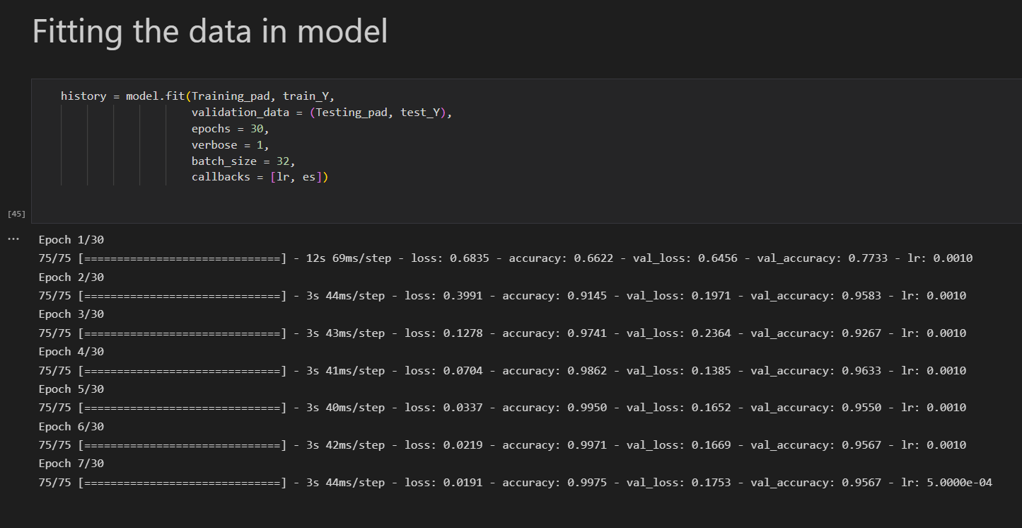
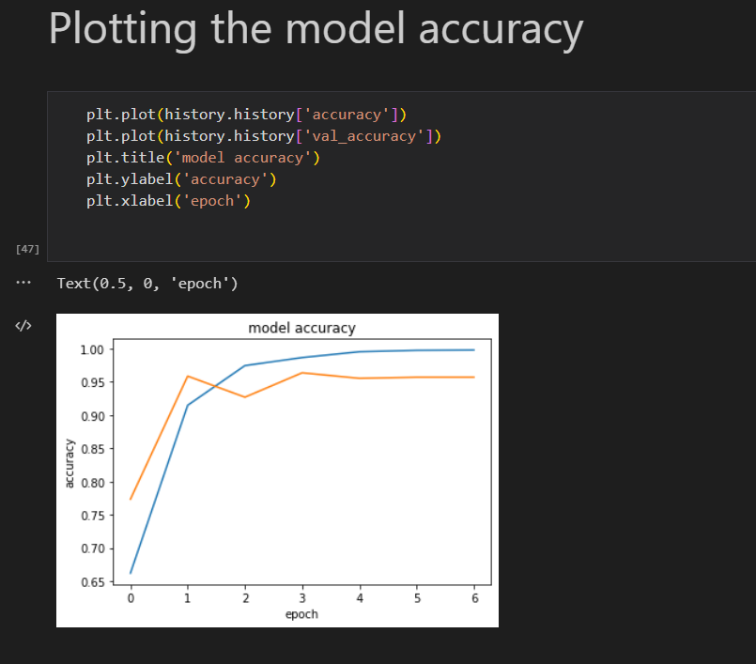

Slide 15
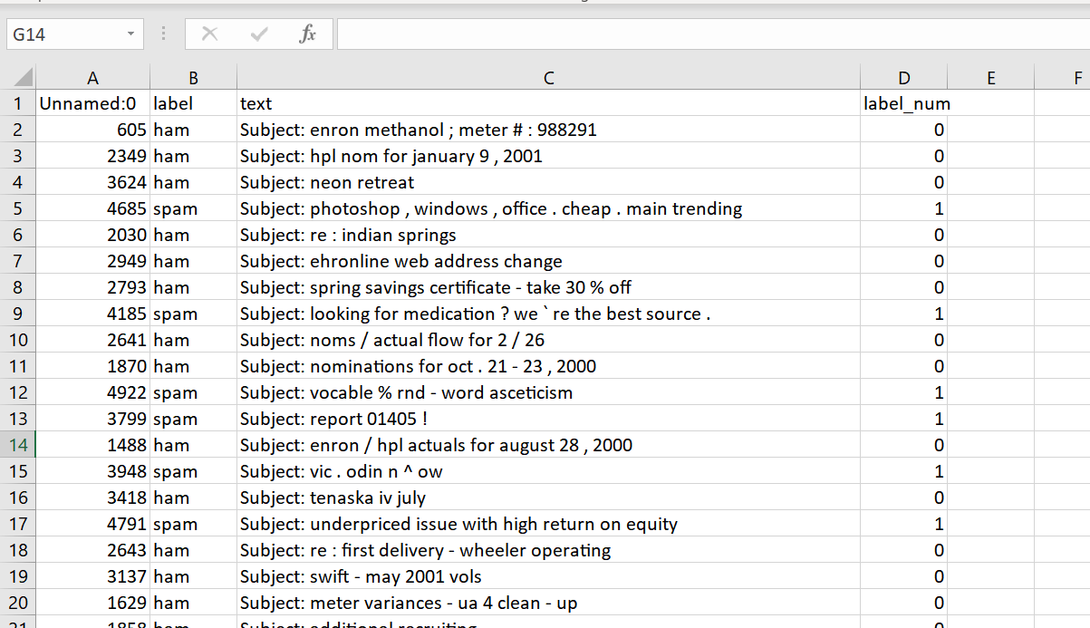
DATASET
Collection of related information or data.
Dataset being used here is a collection of spam and non-spam messages(ham).

Slide 16
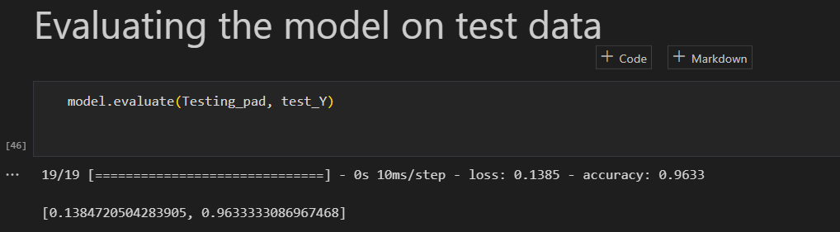
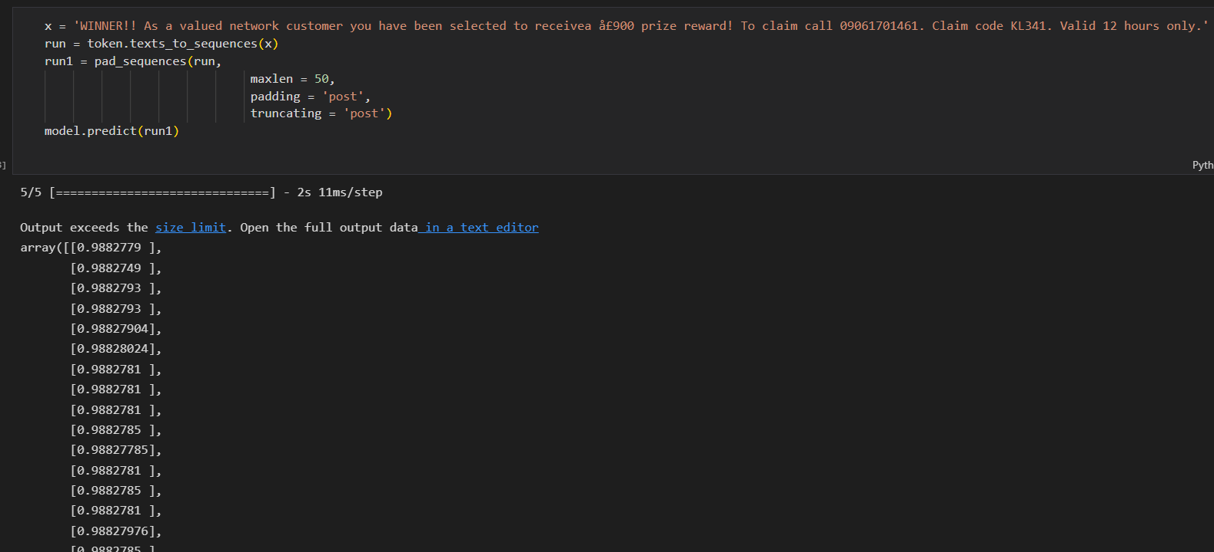
OUTPUT
Our model can classify spam and ham mail.
From the classified data we get an accuracy of 96.3%

Slide 17
CONCLUSION
We can classify spam or non-spam emails using our model. It can be used along with existing methods to further increase spam filters' screening process and accuracy.
The developed model will be more beneficial for small private companies or firms.

Slide 18

REFERENCES
https://www.geeksforgeeks.org/detecting-spam-emails-using-tensorflow-in-python/
https://pythonbaba.com/email-spam-classification-project-report/
https://www.sciencedirect.com/science/article/pii/S2405844018353404
https://www.kaggle.com/datasets/venky73/spam-mails-dataset

Slide 19

Thank you for your attention

